Slide 1
EasyVisa Project Business Presentation

Slide 2
Contents
● Business Problem Overview
● Data Overview
● Exploratory Data Analysis (EDA)
● Model Performance Summary
● Business Insights and Recommendations

Slide 3
Business Problem Overview and Solution Approach Context
Business communities in the United States are facing high demand for human resources, but one of the constant challenges is identifying and attracting the right talent, which is perhaps the most important element in remaining competitive. Companies in the United States look for hard-working, talented, and qualified individuals both locally as well as abroad.
The Immigration and Nationality Act (INA) of the US permits foreign workers to come to the United States to work on either a temporary or permanent basis. The act also protects US workers against adverse impacts on their wages or working conditions by ensuring US employers' compliance with statutory requirements when they hire foreign workers to fill workforce shortages. The immigration programs are administered by the Office of Foreign Labor Certification (OFLC).
OFLC processes job certification applications for employers seeking to bring foreign workers into the United States and grants certifications in those cases where employers can demonstrate that there are not sufficient US workers available to perform the work at wages that meet or exceed the wage paid for the occupation in the area of intended employment.

Slide 4
Objective:
In FY 2016, the OFLC processed 775,979 employer applications for 1,699,957 positions for temporary and permanent labor certifications. This was a nine percent increase in the overall number of processed applications from the previous year. The process of reviewing every case is becoming a tedious task as the number of applicants is increasing every year.
The increasing number of applicants every year calls for a Machine Learning based solution that can help in shortlisting the candidates having higher chances of VISA approval. OFLC has hired your firm EasyVisa for data-driven solutions. You as a data scientist have to analyze the data provided and, with the help of a classification model:
* Facilitate the process of visa approvals.
* Recommend a suitable profile for the applicants for whom the visa should be certified or denied based on the drivers that significantly influence the case status.

Slide 5
Data overview
case_id: ID of each visa application
continent: Information of continent the employee
education_of_employee: Information of education of the employee
has_job_experience: Does the employee has any job experience? Y= Yes; N = No
requires_job_training: Does the employee require any job training? Y = Yes; N = No
no_of_employees: Number of employees in the employer's company
yr_of_estab: Year in which the employer's company was established
region_of_employment: Information of foreign worker's intended region of employment in the US.
prevailing_wage: Average wage paid to similarly employed workers in a specific occupation in the area of intended employment. The purpose of the prevailing wage is to ensure that the foreign worker is not underpaid compared to other workers offering the same or similar service in the same area of employment.
unit_of_wage: Unit of prevailing wage. Values include Hourly, Weekly, Monthly, and Yearly.
full_time_position: Is the position of work full-time? Y = Full Time Position; N = Part Time Position
case_status: Flag indicating if the Visa was certified or denied
The dataset has 25480 rows and 12 columns.
There are no duplicates in the data.
There are no missing values in the dataset.

Slide 6
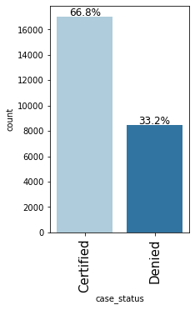
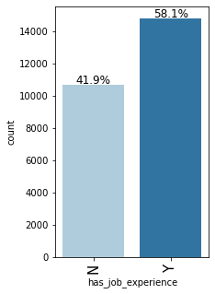
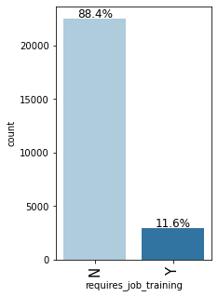
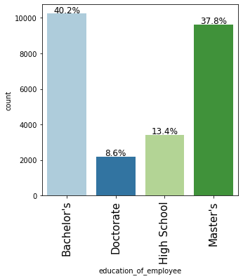
EDA (univariate)

Slide 7
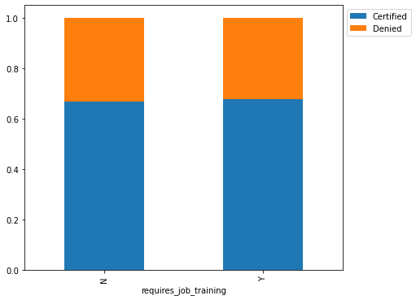
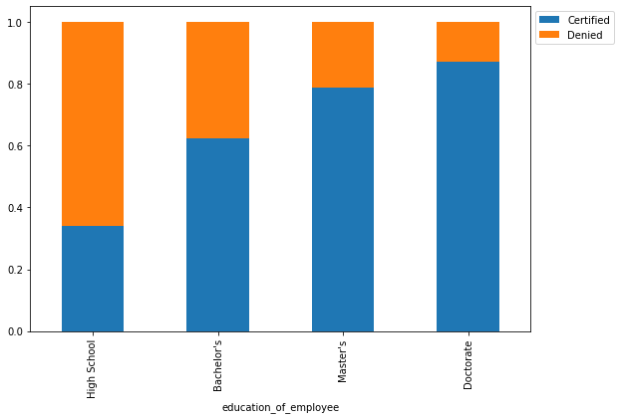
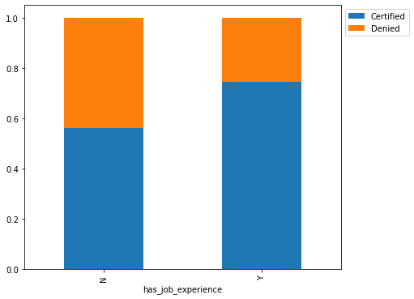
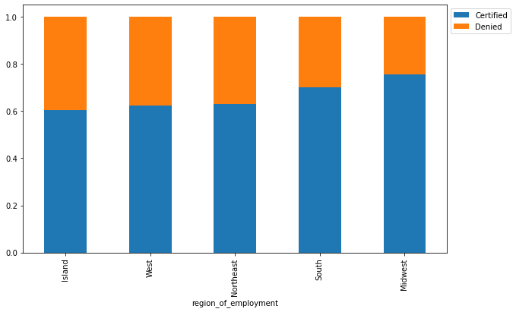
Bivariate analysis

Slide 8
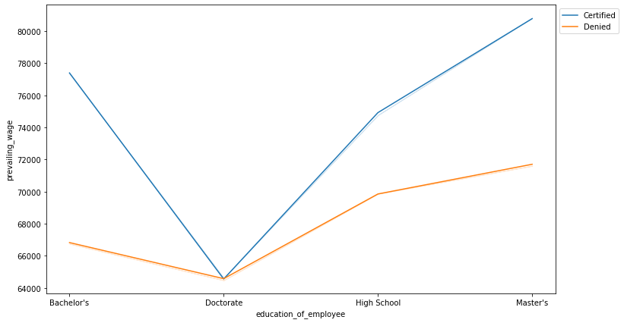
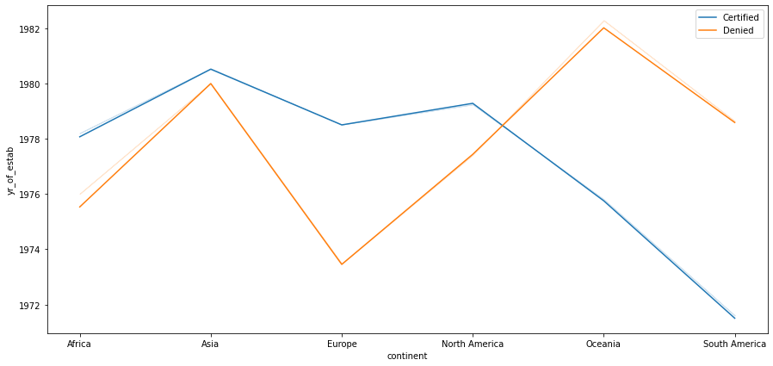
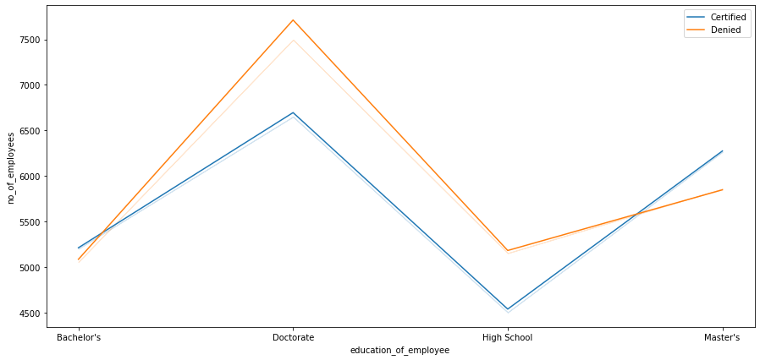
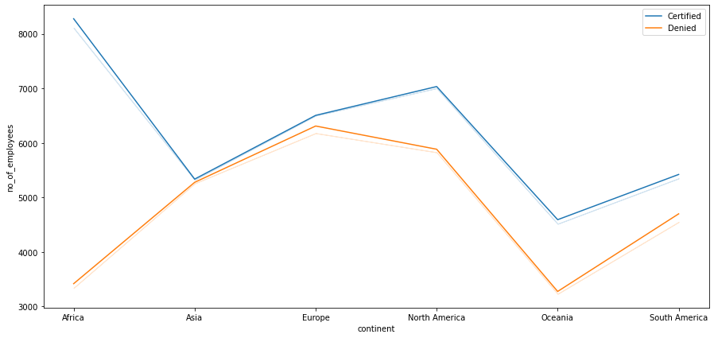
Bivariate analysis

Slide 9
Model evaluation criterion
Model can make wrong predictions as:
1. Model predicts that the visa application will get certified but in reality, the visa application should get denied.
2. Model predicts that the visa application will not get certified but in reality, the visa application should get certified.
Which case is more important?
Both the cases are important as:
* If a visa is certified when it had to be denied a wrong employee will get the job position while US citizens will miss the opportunity to work on that position.
* If a visa is denied when it had to be certified the U.S. will lose a suitable human resource that can contribute to the economy.
How to reduce the losses?
F1 Score can be used in the metric for evaluation of the model, greater the F1 score higher are the chances of minimizing False Negatives and False Positives.
We will use balanced class weights so that model focuses equally on both classes if the need be.

Slide 10
Model performance summary for Training data.
 | Decision Tree | Decision Tree Estimator | Random Forest Estimator | Random Forest Tuned | Bagging Classifier | Bagging Estimator Tuned | Adaboost Classifier | Adabosst Classifier Tuned | Gradient Boost Classifier | Gradient Boost Classifier Tuned | Stacking Classifier
Accuracy | 1.0 | 0.733741 | 0.999888 | 0.766652 | 0.984245 | 0.997028 | 0.737329 | 0.750841 | 0.756279 | 0.755326 | 0.760765
Recall | 1.0 | 0.913653 | 1.000000 | 0.899966 | 0.985130 | 0.999578 | 0.886617 | 0.886617 | 0.875549 | 0.875549 | 0.877408
Precision | 1.0 | 0.743690 | 0.999831 | 0.781511 | 0.991075 | 0.995959 | 0.758401 | 0.771845 | 0.782881 | 0.781877 | 0.786683
F1 | 1.0 | 0.819957 | 0.999916 | 0.836566 | 0.988094 | 0.997765 | 0.817513 | 0.825260 | 0.826626 | 0.826066 | 0.829572

Slide 11
Model performance summary for Test data.
 | Decision Tree | Decision Tree Estimator | Random Forest Estimator | Random Forest Tuned | Bagging Classifier | Bagging Estimator Tuned | Adaboost Classifier | Adabosst Classifier Tuned | Gradient Boost Classifier | Gradient Boost Classifier Tuned | Stacking Classifier
Accuracy | 0.660911 | 0.739011 | 0.727630 | 0.750131 | 0.696232 | 0.726060 | 0.737572 | 0.748823 | 0.751177 | 0.751308 | 0.752616
Recall | 0.738904 | 0.909687 | 0.834427 | 0.885179 | 0.773640 | 0.885565 | 0.885565 | 0.880548 | 0.867040 | 0.869162 | 0.868005
Precision | 0.755525 | 0.755328 | 0.779380 | 0.777194 | 0.777239 | 0.753530 | 0.764578 | 0.778138 | 0.787417 | 0.786450 | 0.788431
F1 | 0.747122 | 0.825352 | 0.805965 | 0.827680 | 0.775435 | 0.814230 | 0.820637 | 0.826181 | 0.825312 | 0.825740 | 0.826307

Slide 12
Profile for the applicants for whom the visa should be certified or denied based on the drivers that significantly influence the case status.
Certified
Applicant must have a higher education(master's or doctorate).
Job experience by applicant in that industry is very necessary.
Applicant must be from Europe since their skills set and education match up to the one here.
Probability for an applicant to work in Midwest is higher than other states .
A high prevailing wage is also necessary.
Denied
Applicant with high school certificate.
Applicant needs training to work which will be a cost to the company.
Applicant is from Oceania since they have the lowest rate of approval.

Slide 13
CONCLUSION
We can see that three variables-education_of_employee_high school,has_job_experience_Y and prevailing_wage are the most important factors to determine the case status of an employee.
Once the desired performance is achieved from the model, the company can use it to predict the case status in new applicants. This would help to reduce the cost and increase the efficiency of the process.
Education of employee(high school, master's and doctorate) appears in the first five variables that determine the case status. High school visa applicants had the highest denied case status so a higher education can secure their approval.
A lot of companies require job applicants to have experience from their previous jobs before hiring. It is the number of years experience that gives the company the confidence of hiring the right person for the job.
A visa application has a higher probability of approval if the applicant is from Europe compared to other continent.
Also in future data collection the reason for denied visa must be stated.
Visa could be denied due to; ;Errors in application ;Presentation of wrong documents ;Applying for the wrong type of visa. ;False information etc

